Slide 1




Online Private Tutor
Finder System
BY GROUP-9

Slide 2

ABSTRACT
Now a days Tutorial Points are becoming useful to the students who are in the search of quality education. So, this application provides the support for both the tutors and students. The Admin is the head of this application who can view the students and tutors registered into the application. Admin will add the courses. The tutors who need to be registered and login and can select the course he would like teach by providing location and timings.
Students who also need to register and login into the application while registering student will give the location and after logging when he selects the course. The tutors available in that location and the course that tutor can teach both are matched and the request will be sent to admin. Admin will confirm the request therefore student can view the tutor details.

Slide 3
MODULE
ADMIN
TUTOR
PARENT
Admin will login with the default username and password. Admin can view the registered tutors and students. He can also view the requests from tutors. Admin will confirm the requests then the details of tutors are shown to student and the tutor will be assigned to student.
Tutor will login and register into the application by giving the username and password, after logging in tutor will select the course and location and the timings with his availability. If any student requests were there in that locality the tutor will be assigned to student.
Parent will register and login into the application by giving username and password and student need to select the course and timings and if any tutors available in that area the request will be forwarded to admin, admin will confirm the request the tutor will be assigned to student.

Slide 4
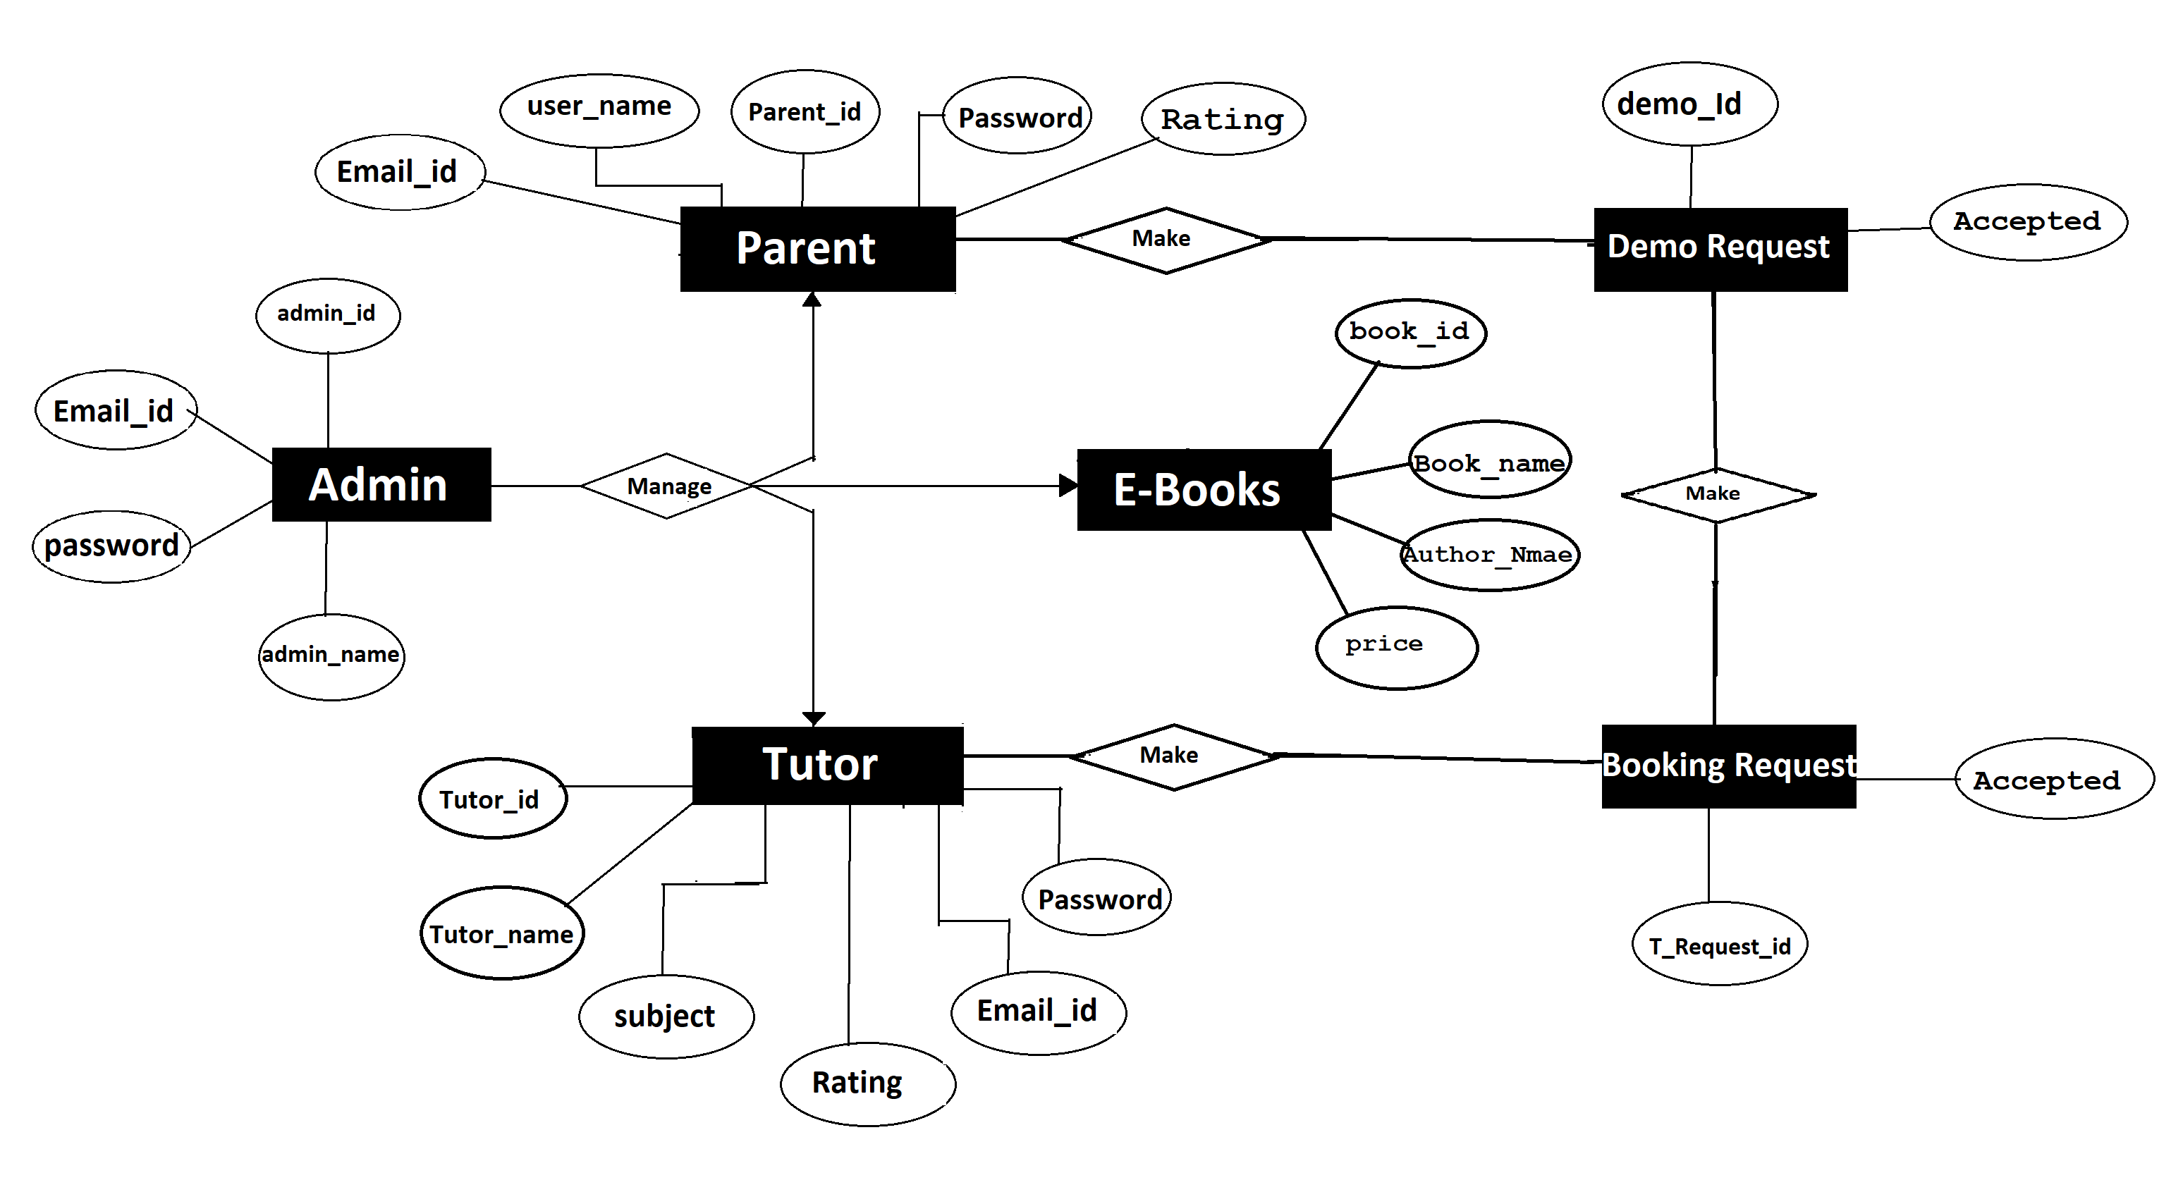
ER DIAGRAM

Slide 5
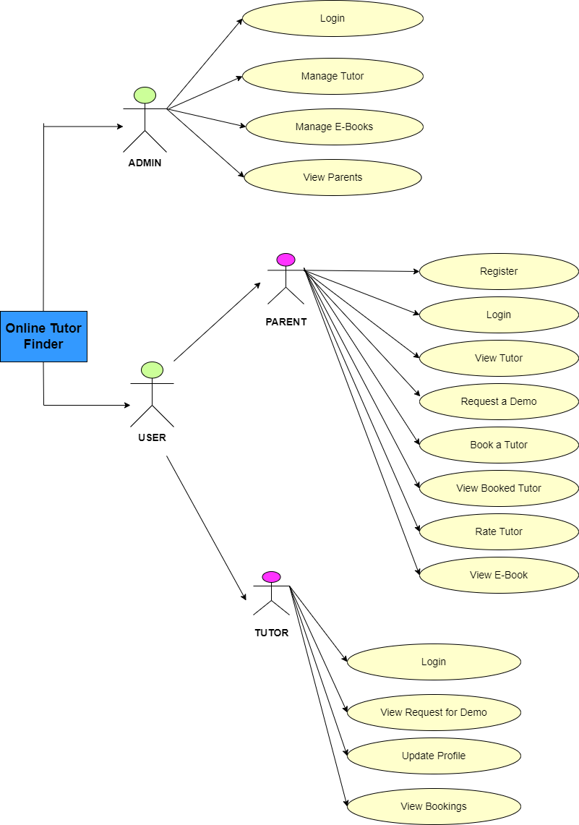
USE-CASE DIAGRAM

Slide 6
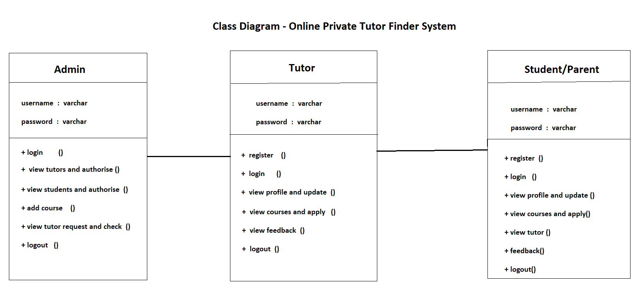
CLASS DIAGRAM

Slide 7
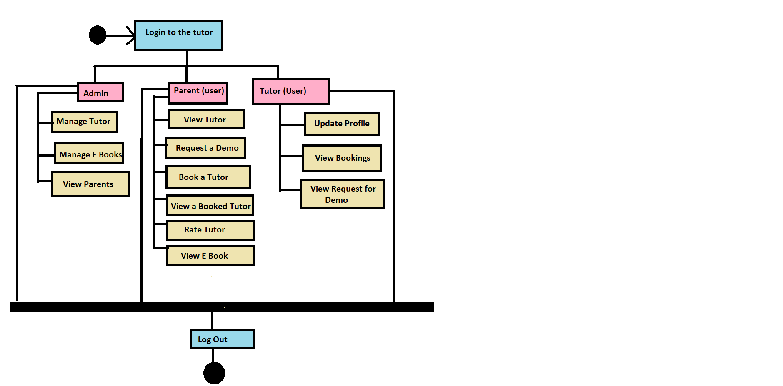
ACTIVITY DIAGRAM

Slide 8
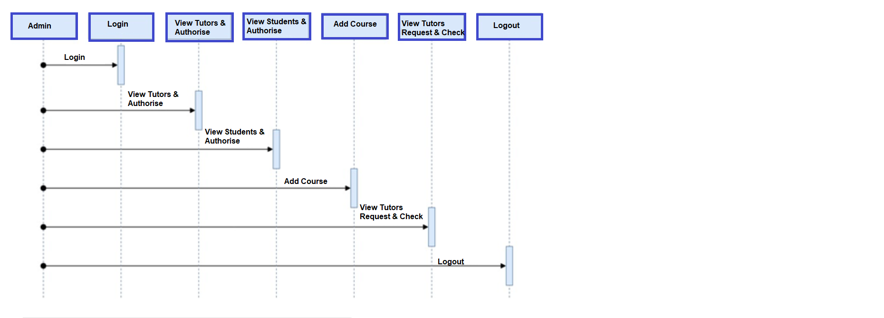
SEQUENCE DIAGRAM
ADMIN:-

Slide 9
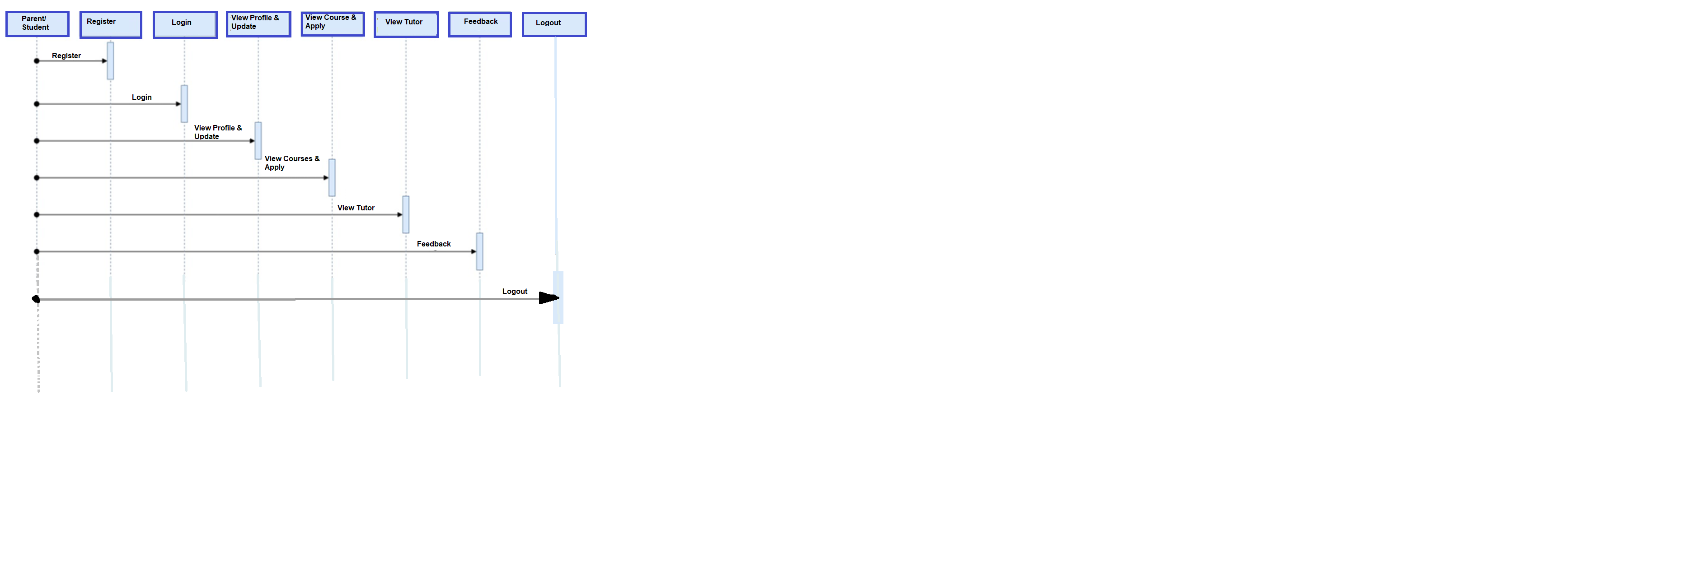
PARENT/STUDENT:-

Slide 10
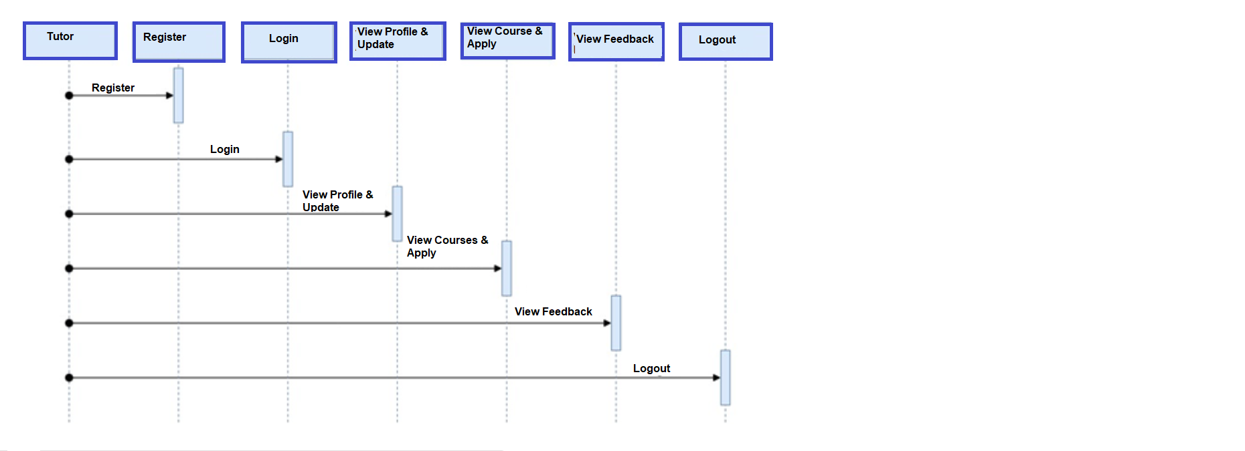
TUTOR:-

Slide 11
THANK YOU

